Slide 1
DOM

Slide 2
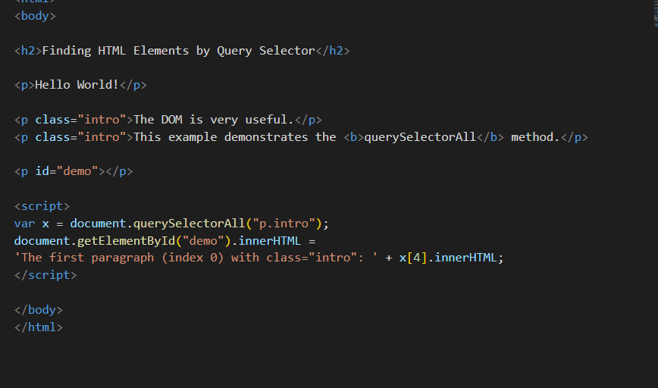
CSS QuerySelector

Slide 3
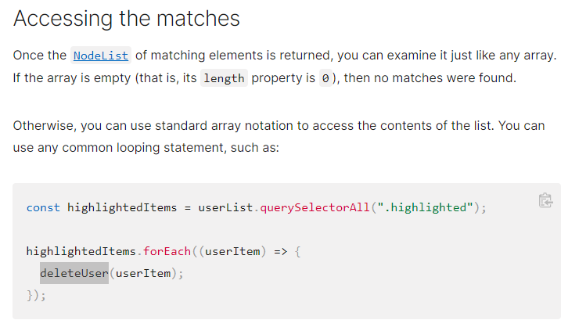
CSS QuerySelector

Slide 4
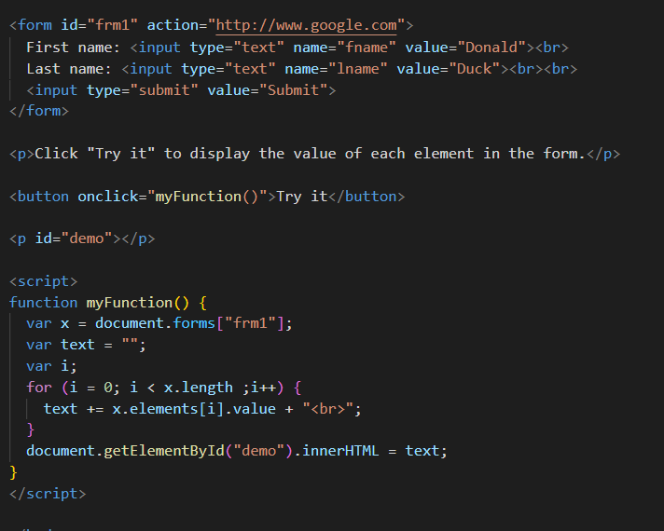
Form Object Collection

Slide 5
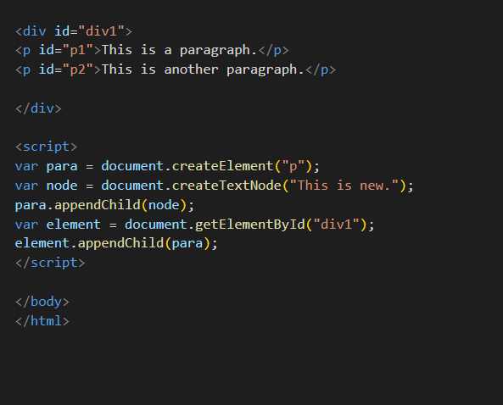
ADD DOM

Slide 6
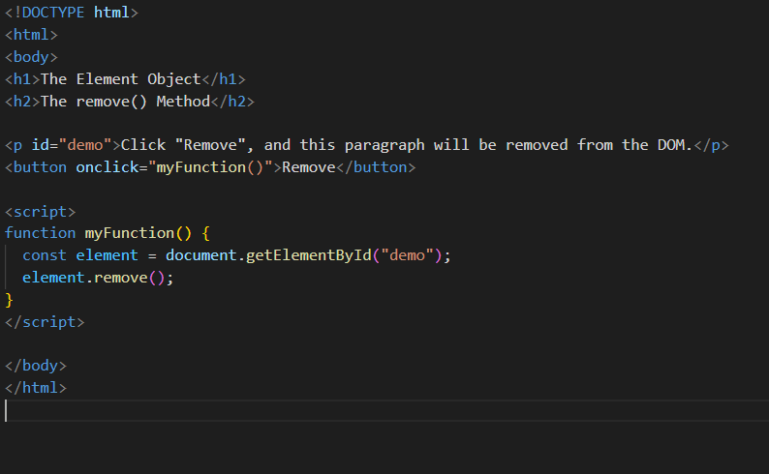
Remove DOM

Slide 7
DOM Methods accessing attributes and styles
getElementById - To change/modify the content of an HTML element
<script>
document.getElementById("p1").innerHTML = "New text!";
</script>
Changing HTML Content
<script>
document.getElementById("myImage").src = "landscape.jpg";
</script>
Changing the Value of an Attribute
<script>
document.getElementById("myP").style.backgroundColor = "red";
</script>
Changing Style property
<script>
document.getElementById("myP").classList.add(“box”); </script>

Slide 8
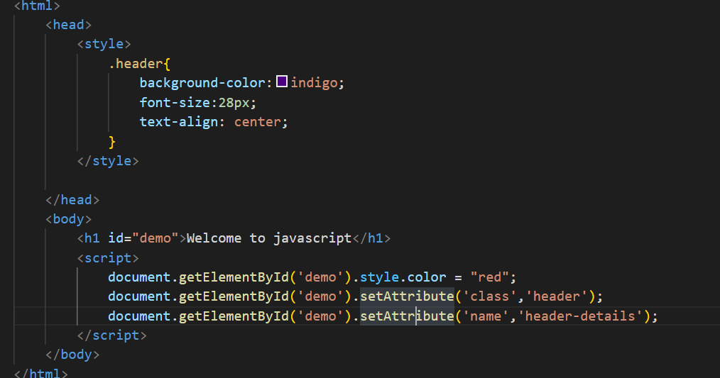
Style and class

Slide 9
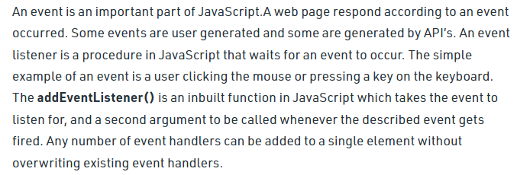
Events

Slide 10
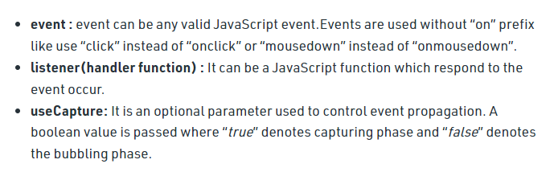
Events

Slide 11
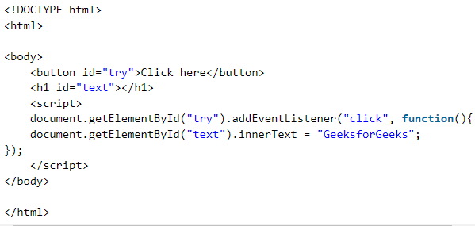
Events

Slide 12
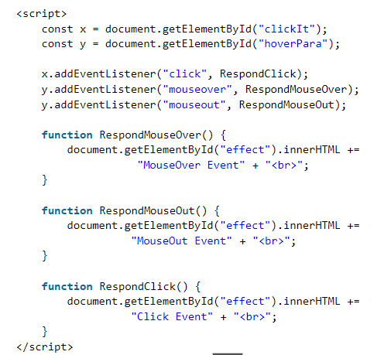
Events

Slide 13
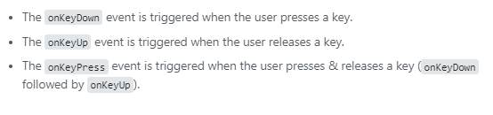
Events

Slide 14
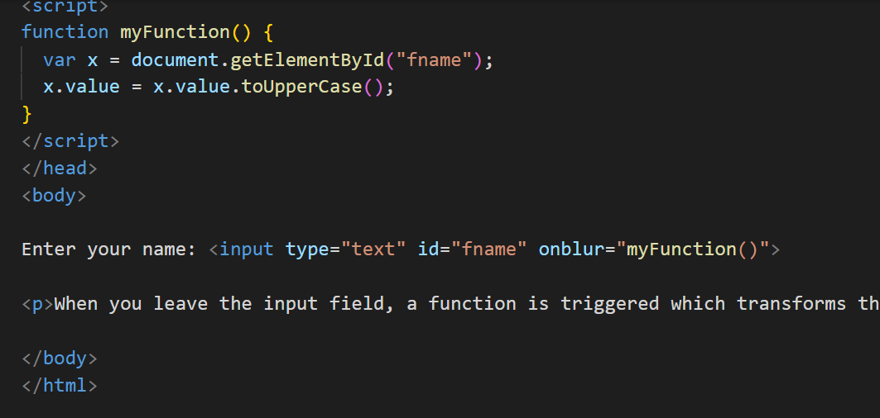
onBlur

Slide 15
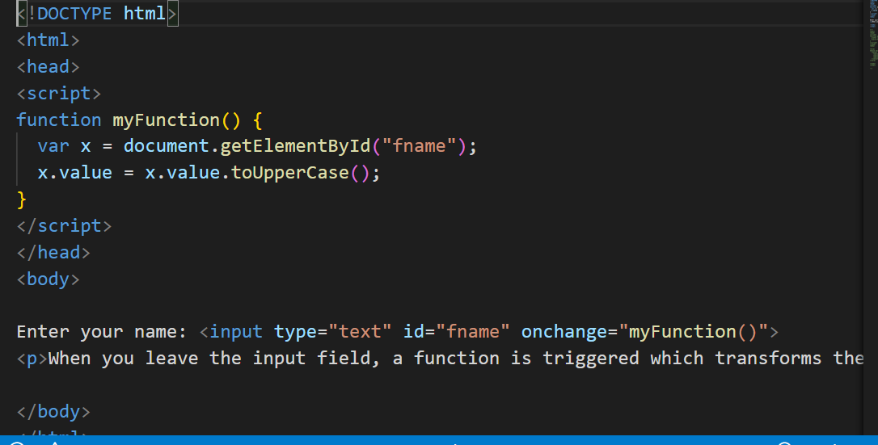
onChange

Slide 16
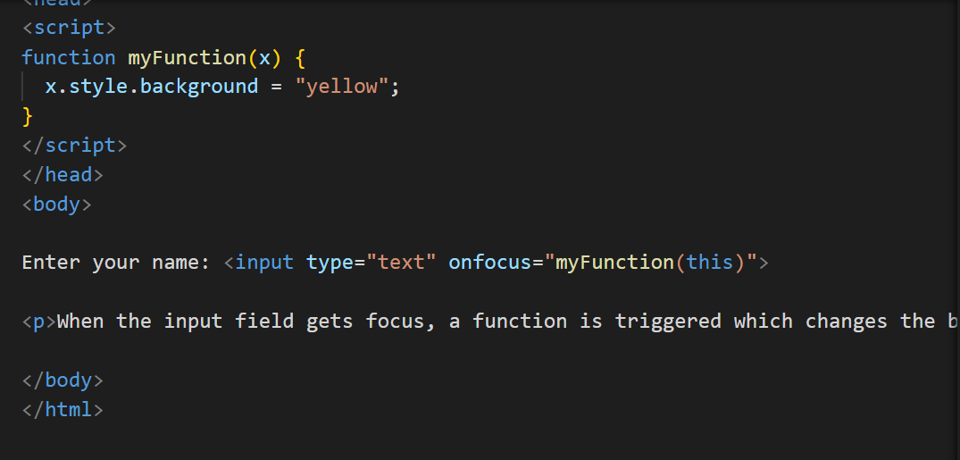
onFocus

Slide 17
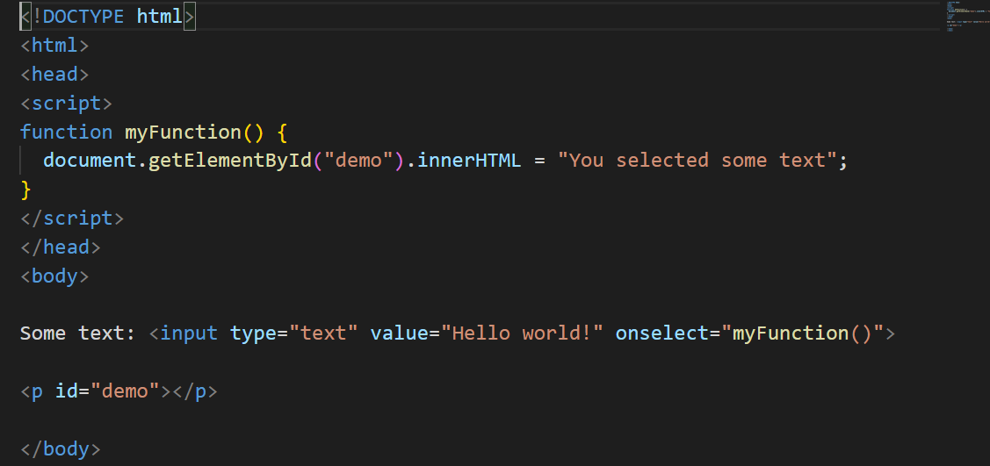
onSelect

Slide 18
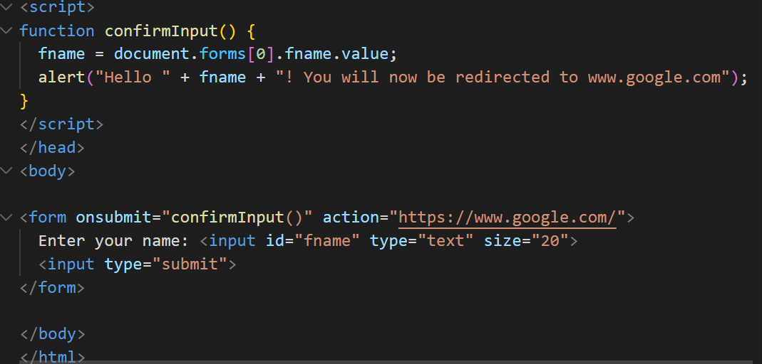
onSubmit

Slide 19
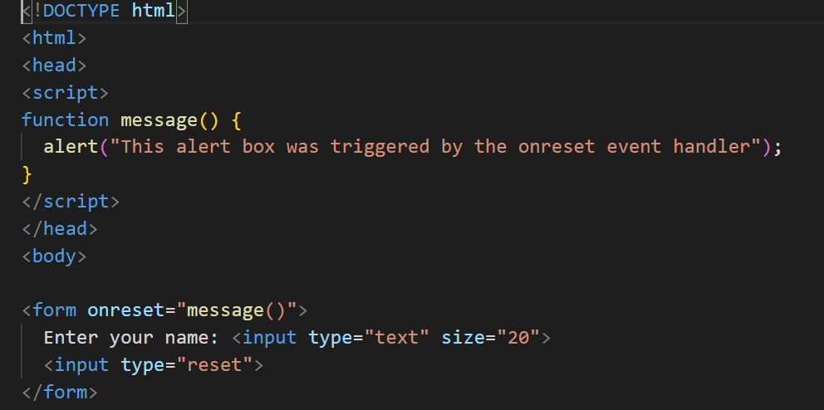
onReset

Slide 20
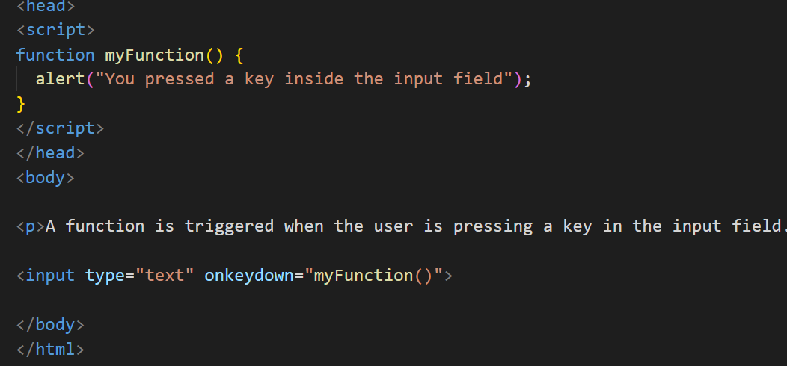
onKeyDown

Slide 21
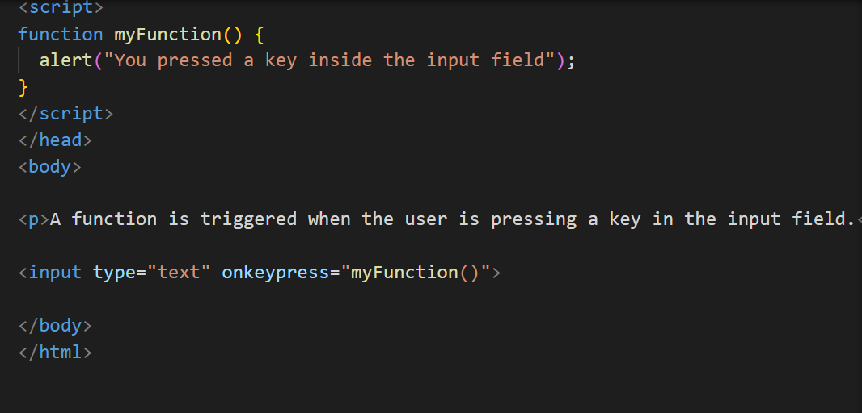
onKeyPress

Slide 22
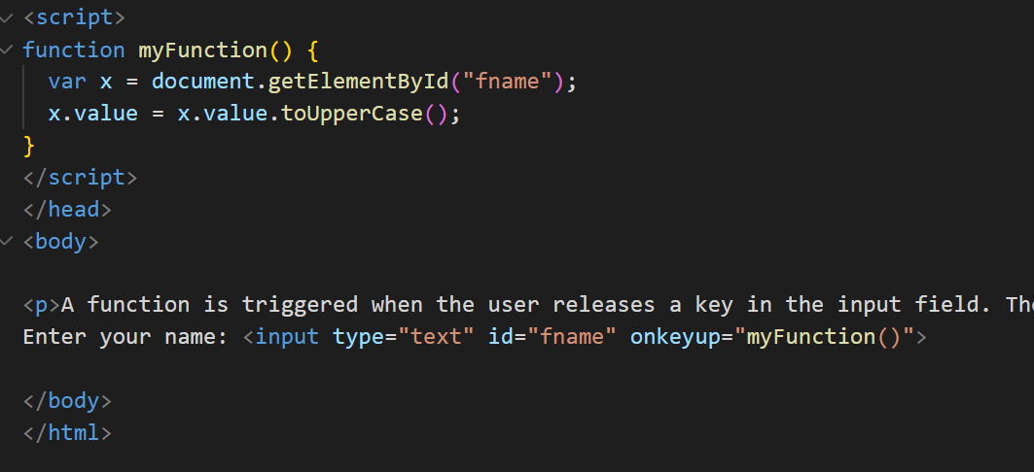
onKeyUp

Slide 23
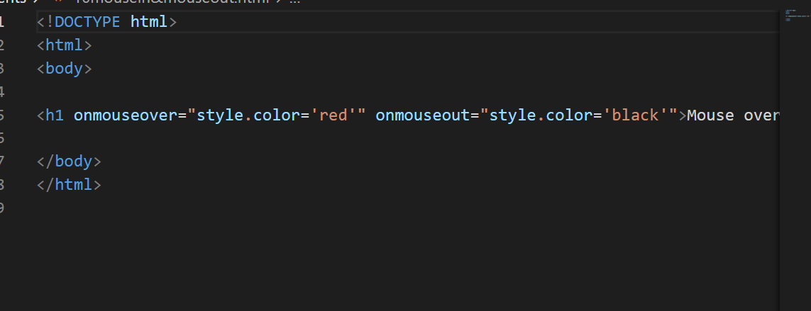
onMouseOver and onMouseOut

Slide 24
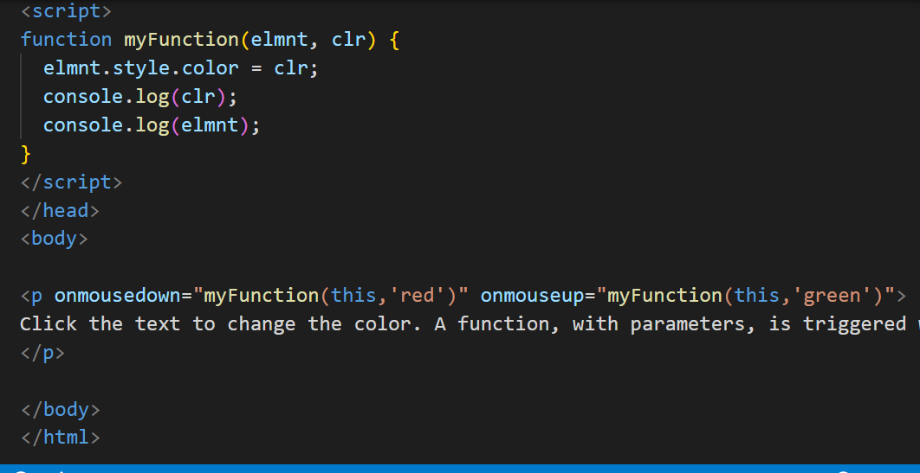
onMouseDown and onMouseUp

Slide 25
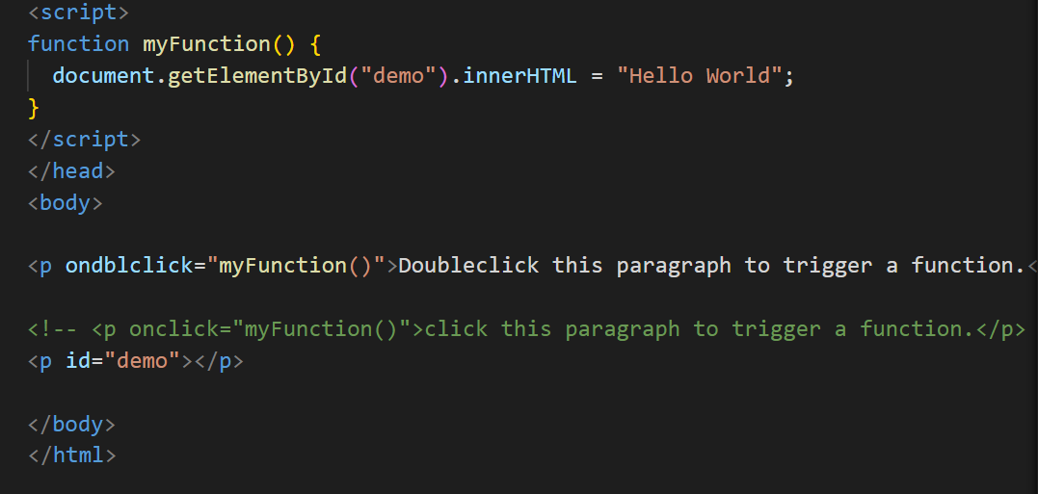
onDoubleClick

Slide 26
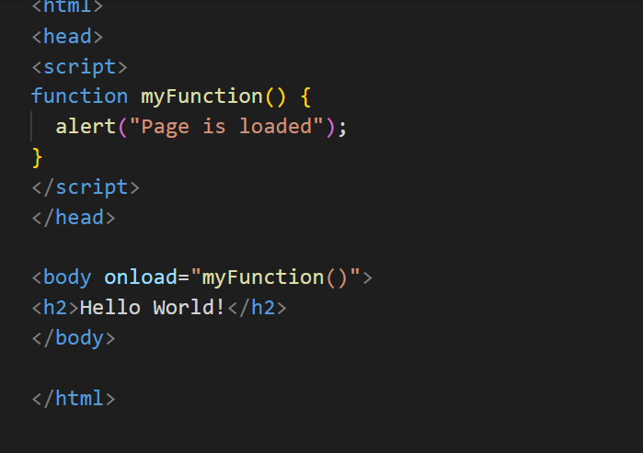
onLoad

Slide 27
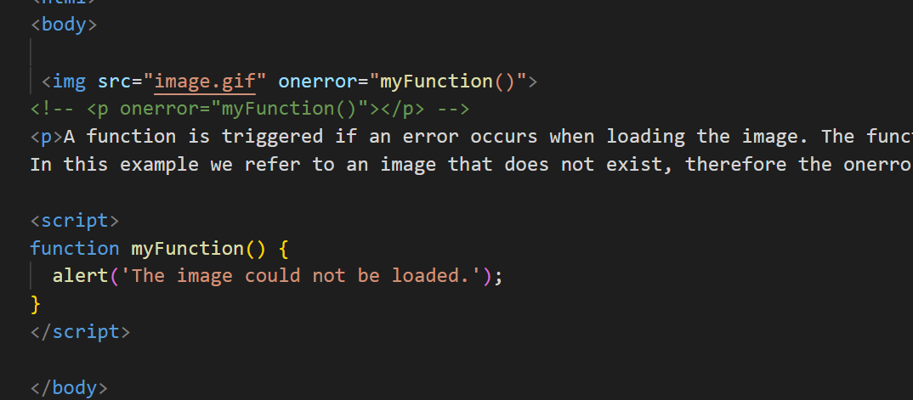
onError

Slide 28
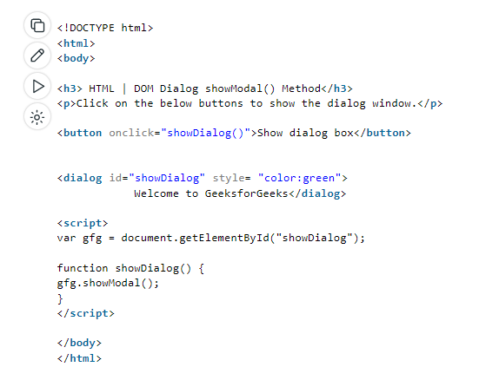
DOM Modal - showModal()

Slide 29
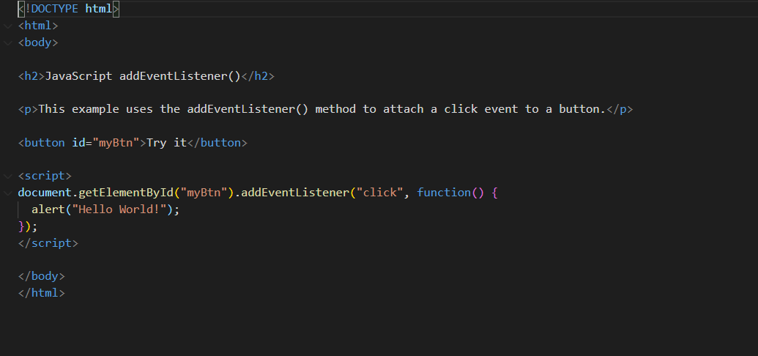
Event Listener

Slide 30
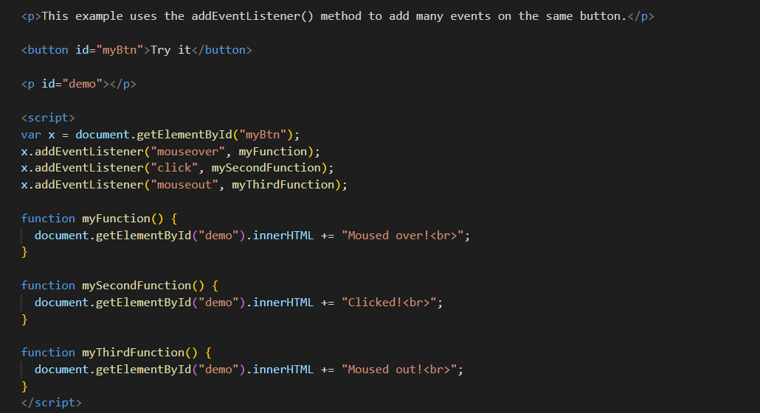
Event Listener

Slide 31
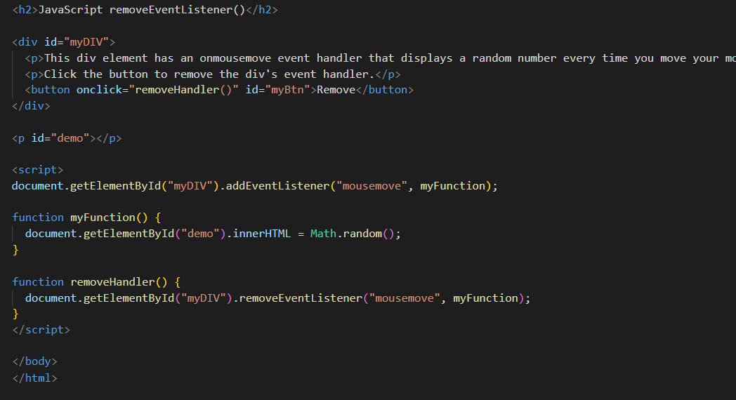
Remove Event Listener

Slide 32
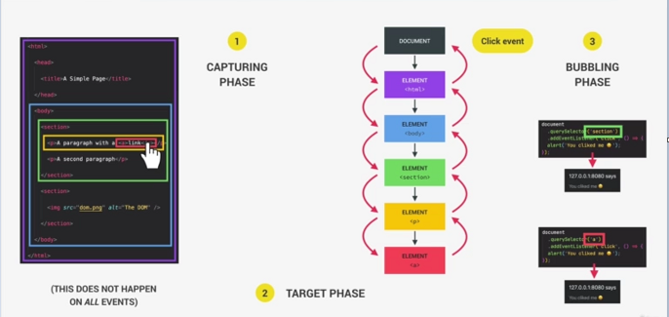
Bubbling and Capturing

Slide 33
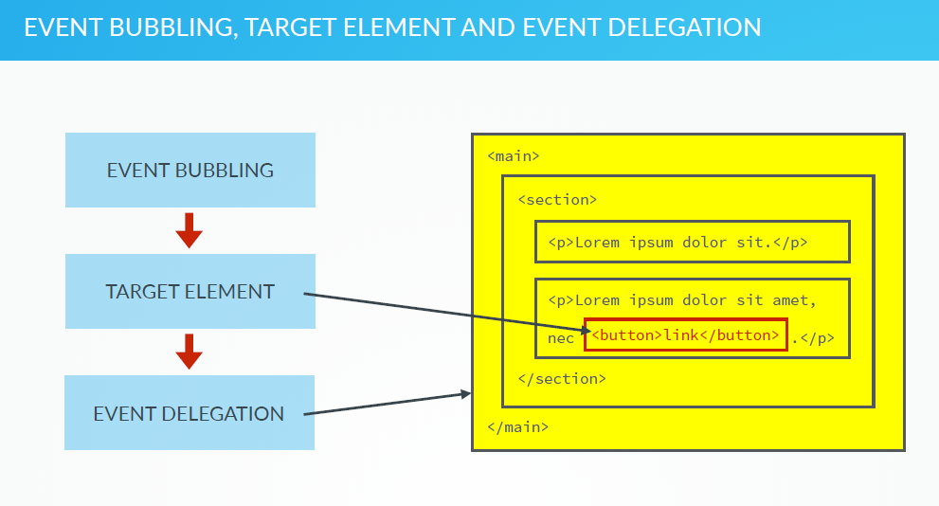

Slide 34
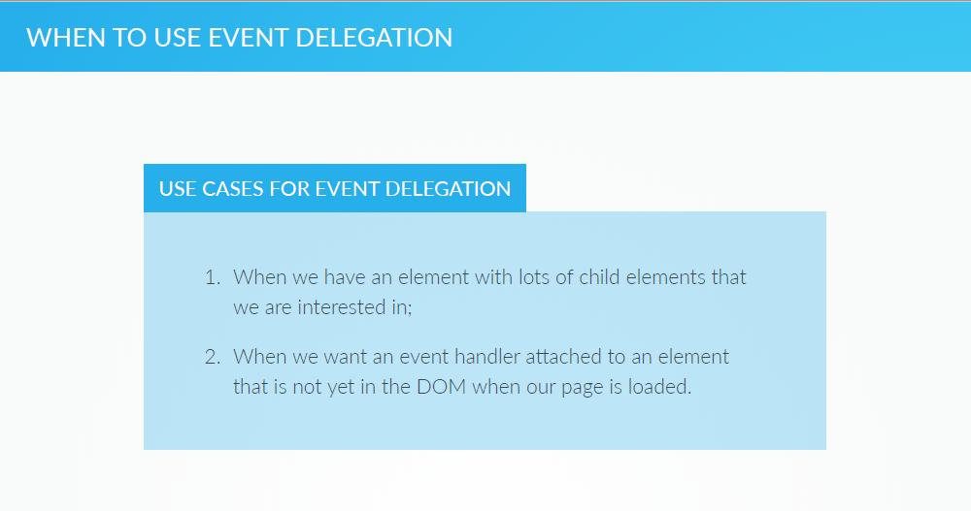

Slide 35
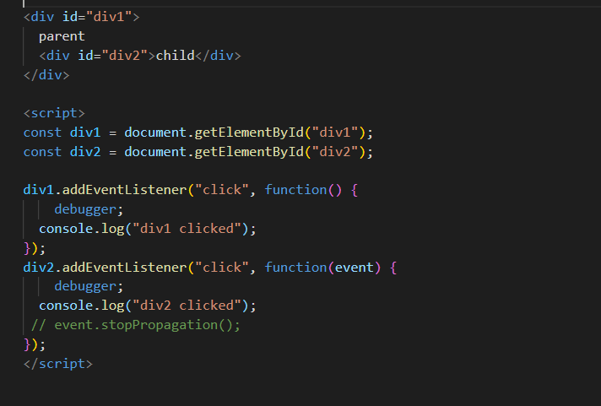
Event Bubbling Example

